Slide 1
THE FUTURE OF 3D PRINTING
MADE BY – GOURAB SARDAR

Slide 2

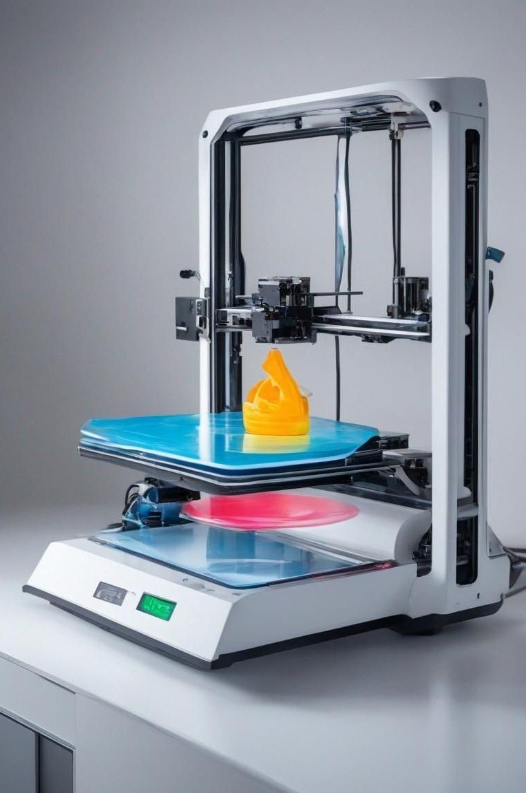







Slide 3





Slide 4
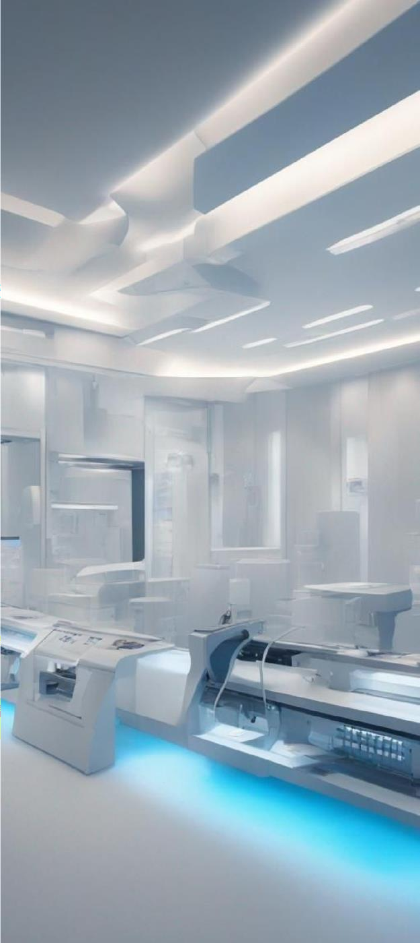








Slide 5






Slide 6









Slide 7
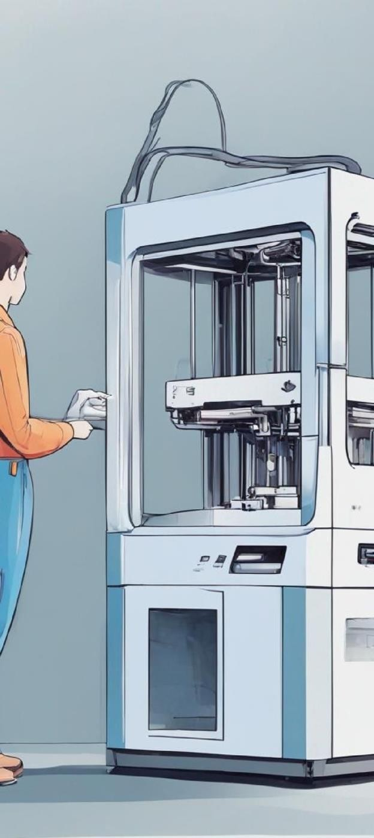


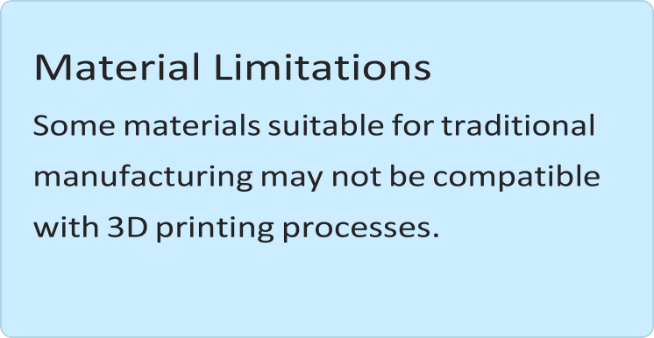
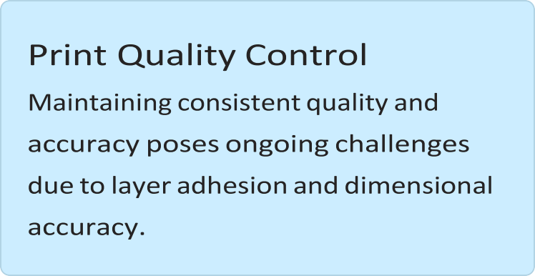


Slide 8
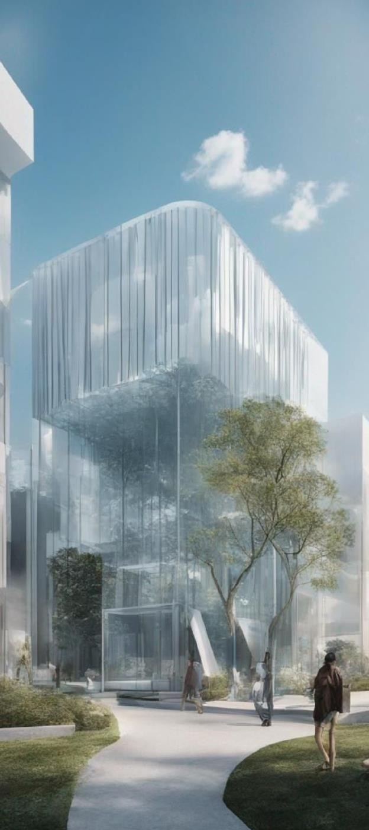






Slide 9





Slide 10









Slide 11









